Slide 1
Mini-Project Progress Review 2
Project Title : Speech Calculator
Project Guide : Dr. Shylaja S S
Project Team (Names & USN): Mohith R - PES1UG19CS277
Sanjiv Sridhar - PES1UG19CS432
Chinmay Kulkarni - PES1UG19CS127

Slide 2
Project Abstract and Scope
Provide a basic introduction of the Project
and also an overview of the scope it entails.

Slide 3
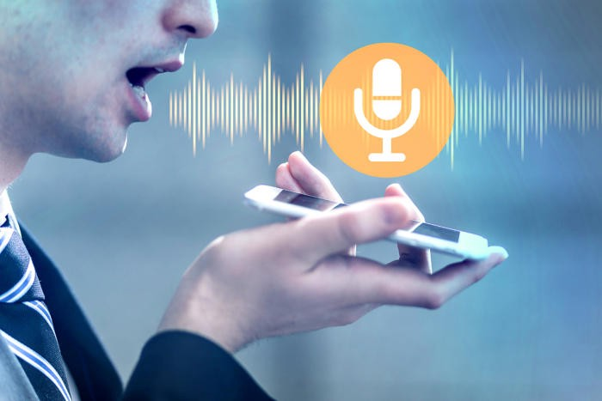
Project Abstract and Scope

Slide 4
Suggestions from Review - 1
Provide the suggestions and remarks given by
the panel members.
Mention the feasibility on the same showing
the progress.

Slide 5
Suggestions from Review - 1

Slide 6
Project Requirements
Specify the project requirements:
Functional requirements.
Non-functional requirements

Slide 7
Project Requirements

Slide 8
Detailed Literature Survey
2 recently published research papers/products.
Summarize the individual papers/products with as much detail as each deserves, depending up on its relative importance in the overall literature on the topic.

Slide 9
Detailed Literature Survey
Automatic Speech Recognition Technique For Voice Command
Anshul Gupta, Nileshkumar Patel, Shabana Khan
Jaypee University of Engineering & Technology, Guna M.P India
Summary and Proposed Solution :
The proposed solution is to take a single audio as an input and then eliminate the presence of noise, then match the patterns to recognize the input audio.
The error tolerance mechanism is implemented so that it can be robust against human errors, environment noise.

Slide 10
Detailed Literature Survey
Mathifier – Speech Recognition of Math Equations
Salim N. Batlouni, Hala S. Karaki, Fadi A. Zaraket, Fadi N. Karameh
American University of Beirut
Summary and Proposed Solution :
Mathifier constricts the speech recognition to math equations; it takes as input math formulas presented in the form of user speech and produces the equations in digital mathematical form.
The smaller dictionary and the specific grammar structure of the math equations help restrict the problem of the recognition process.

Slide 11
System Design
Design Description
Block Diagram
Flowchart / Data Flow Diagram

Slide 13
Technologies Used
What technologies you plan to use
and why ?

Slide 14
Technologies Used
The technologies/platforms/languages planned to be used in this project are:
Python 3.x
Tensorflow 2.x
Natural Language Processing
Flutter
Dart
Android Studio
pyaudio with Google recognizer
<Why we need to use>

Slide 15
Project Progress So far
What is the project progress so far?
What is the percentage completion of the project?

Slide 16
Conclusion
Conclusion of the progress of the project done so far.

Slide 17
References
List of research papers referred :
[1] S. Furui, “Recent advances in robust speech recognition,” in Proc. ESCA-NATO Tutorial and Research Workshop on Robust Speech Recognition for Unknown Communication Channels, Pont-a-Mousson, France, Apr. 1997, pp. 11–20.
[2] Gupta, Anshul; Patel, Nileshkumar; Khan, Shabana (2014). [IEEE 2014 International Conference on Science Engineering and Management Research (ICSEMR) - Chennai, India (2014.11.27-2014.11.29)] 2014 International Conference on Science Engineering and Management Research (ICSEMR) - Automatic speech recognition technique for voice command.
[3] Y.-F. Gong, “Speech recognition in noisy environments: A survey,” Speech Commun., vol. 16, pp. 261–291, 1995.
[4] B.-H. Juang, “Speech recognition in adverse environments,” Comput. Speech Lang., vol. 5, pp. 275–294, 1991.
[5] S. Young and N. Ressell, “Token passing: a simple conceptual model for connected speech recognition systems,” Cambridge University Engineering Department, 1989.
[6] Batlouni, Salim N.; Karaki, Hala S.; Zaraket, Fadi A.; Karameh, Fadi N. (2011). [IEEE 2011 18th IEEE International Conference on Electronics, Circuits and Systems - (ICECS 2011) - Beirut, Lebanon (2011.12.11-2011.12.14)] 2011 18th IEEE International Conference on Electronics, Circuits, and Systems - Mathifier - Speech recognition of math equations.

Slide 18
Thank You

